Slide 1
TIHEI TĀKITIMU
IWI MĀORI PARTNERSHIP BOARD
PROGRESS/PRIORITIES REPORT

Slide 2
AGENDA
01. Context
02. Progress
03. Priorities
04. On the radar
05. What’s next?
October 2024
PROGRESS REPORT FOR MATARIKI GOVERNANCE GROUP
2

Slide 3
CONTEXT – OUR PURPOSE
the needs and aspirations of Māori in relation to hauora Māori outcomes;
how the health sector is performing in relation to those needs and aspirations;
the design and delivery of services and public health interventions
October 2024
PROGRESS REPORT FOR MATARIKI GOVERNANCE GROUP
3

Slide 4
CONTEXT - THE PROGRAMME
1. WHĀNAU VOICE
Engage with whānau and hapū about local health needs and communicate results and insights to HNZ.
2. NEEDS ANALYSIS AND PRIORITY SETTING
Evaluate the current state of hauora Māori to determine priorities for improving hauora Māori.
3. MONITORING
Monitor the local performance of the health system, and report on the activities of HNZ to Māori in our area.
4. INFLUENCE INVESTMENT AND INNOVATION
Engage with HNZ and support its priorities for kaupapa Māori investment and innovation.
5. STRATEGIC COMMISSIONING
Play a key role in local service planning with HNZ and be supported to take on a greater role in strategic commissioning from early 2025.
October 2024
PROGRESS REPORT FOR MATARIKI GOVERNANCE GROUP
4

Slide 5
CONTEXT -TRANSFORMATION
RE-IMAGINE
Phase 4
2025-2026
POWER-UP
Phase 3
2024-2025
EXPLORE
Phase 2
2023-2024
ESTABLISHMENT
Phase 1
2022-2023
October 2024
PROGRESS REPORT FOR MATARIKI GOVERNANCE GROUP
5

Slide 6
PROGRESS
Whānau Voice
Monitoring
Hauora Māori Priorities
Community Health Plan AKA Tihei Takitimu Programme Plan
October 2024
PROGRESS REPORT FOR MATARIKI GOVERNANCE GROUP
6

Slide 7
PROGRESS - Whānau Voice
October 2024
PROGRESS REPORT FOR MATARIKI GOVERNANCE GROUP
7

Slide 8
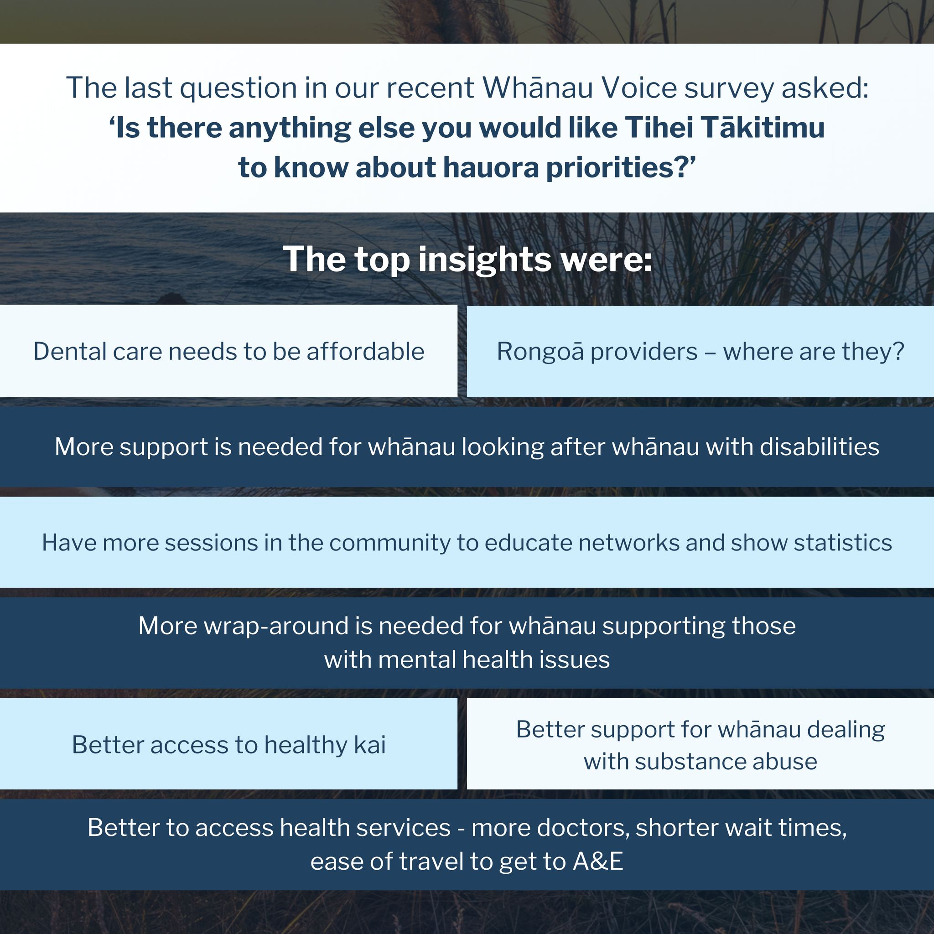
PROGRESS - Whānau Voice
Phase 1 | Whānau Voice
Broad and wide
From December 2023 through to February 2024 – kanohi ki te kanohi and online.
Phase 1.5 | Whānau Voice
Targetting specific areas of interest
From July 2024 through to August 2024 – online.
Phase 2 | Whānau Voice
Collaborate and empower
NOW. Close to announcing an Advisory Panel.
October 2024
PROGRESS REPORT FOR MATARIKI GOVERNANCE GROUP
8

Slide 9
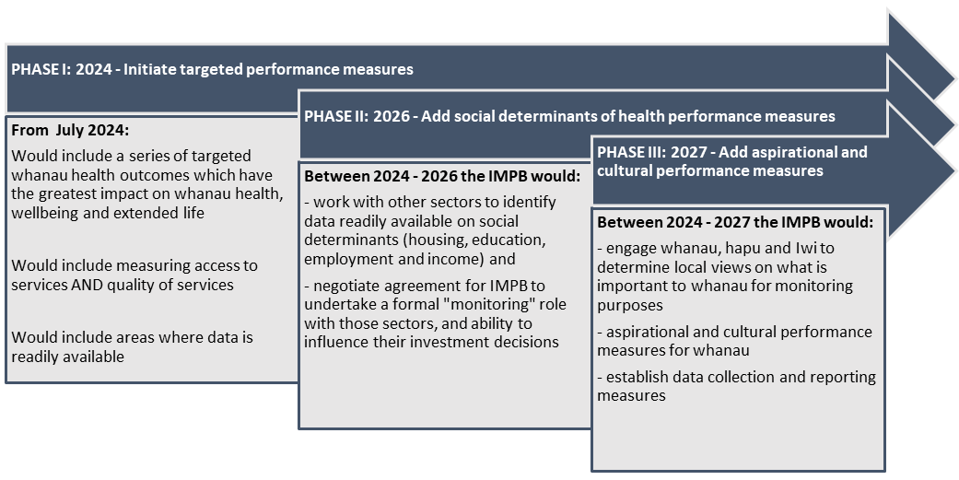
PROGRESS - Monitoring
October 2024
PROGRESS REPORT FOR MATARIKI GOVERNANCE GROUP
9

Slide 10
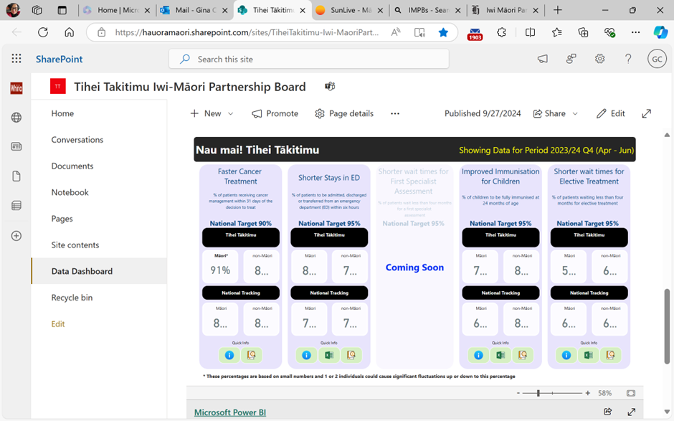
PROGRESS - Monitoring
October 2024
PROGRESS REPORT FOR MATARIKI GOVERNANCE GROUP
10

Slide 11
PROGRESS – Hauora Māori Priorities
Combines data and stories from:
Whānau Voice Phase 1
Tihei Takitimu IMPB – Health Profile Volume 1
Whānau Voice Phase 1.5
Tihei Takitimu IMPB – Health Profile Volume 2
Locality Plan – Te Wairoa
Health Hawkes Bay PHO
Te Whatu Ora
Freely available on our website https://ttpb.maori.nz
October 2024
PROGRESS REPORT FOR MATARIKI GOVERNANCE GROUP
3

Slide 12
PRIORITIES - Public and population health
• Endorse Governments 5 priorities of “modifiable behaviours” alcohol use, smoking/vaping, diet, exercise and social cohesion
• Breast and cervical screening priority. Need more local Māori designed promotional campaigns. Take screening to workplaces. Offer screening out of hours and weekends. Bring mobile services in
• Health promotion and awareness is a big issue for Māori – needs to be localised, local messages and local delivery across the modifiable behaviours. Need a comprehensive end-to-end health promotion approach over the life-course designed, led and delivered by Māori
• Smoking / Vaping: Need education on dangers of vaping
• Kai sovereignty: return control of food to whānau (teach, grow, preserve good food) – needs Māori campaign.
October 2024
PROGRESS REPORT FOR MATARIKI GOVERNANCE GROUP
11

Slide 13
PRIORITIES - Primary and community care
• Endorse the Government’s pathology priorities for chronic conditions: CVD including stroke, diabetes, respiratory and cancer.
• Access to primary care: Need to make more use of mobile clinics. Need to support GP practices with high numbers of Māori patients especially to offer after hours services, making it sustainable, Doctors are moving to walk-ins model instead of booked appointments so they can see more people and this needs to be supported.
• Long-term conditions: Invest in more cancer support persons / navigators – currently there are not enough of the funded cancer navigators and need more pre-risk screening e.g. checking for hardened arteries before people have heart attacks and strokes, pre-diabetes risk screening.
• Building a sustainable primary care funding and delivery model: Important to have a solution as primary care is a gateway to specialists, prescriptions, NASC, home support and good management of chronic conditions. It is a major issue for both rural and urban communities.
October 2024
PROGRESS REPORT FOR MATARIKI GOVERNANCE GROUP
12

Slide 14
PRIORITIES - Primary and community care
Pharmacy: Need to raise awareness with whānau around prescriptions to address issues – getting to GP, getting prescription, picking up prescription, actually taking the prescription, stopping when shouldn’t, disposing of old prescriptions.
Oral Health: Make use of mobile dental (buses) to reach rural communities across all hapori (Wairoa, Ahuriri, Heretaunga and Tamatea) • Promotion to whānau and rangatahi of their entitlement to dental under 18 years - whether at school or not.
NASC and Support Services: Must have choice of Māori assessor. InterRai assessment tool needs to include cultural assessment and people trained to use it properly – important as NASC is gateway to home care.
October 2024
PROGRESS REPORT FOR MATARIKI GOVERNANCE GROUP
13

Slide 15
PRIORITIES - Primary and community care
Mental Health and Addictions: Endorse the Government’s priority for mental health
• Need more community-based services especially with changes to police response and withdrawing from supporting mental health cases.
• Need to build resilience in Rangatahi to cope with stress and strain, trauma otherwise succumb to drugs, gangs, suicide, etc. Support a restorative approach
Rongoā Māori: Need to expand Rongoā Māori offerings across the region
• ACC providers (14 identified in the region) – it is unclear who is endorsing them from a manawhenua perspective to ensure they are upholding local tikanga
October 2024
PROGRESS REPORT FOR MATARIKI GOVERNANCE GROUP
14

Slide 16
PRIORITIES - Hospital and specialist services
•Endorsed Government’s priorities of Health Targets: faster cancer treatment, shorter wait times for FSAs and shorter wait times for Planned Care – adding that there needs to be an equity focus to ensure “everyone” including Māori is benefitting equally from these efforts
• Te Whatu Ora to provide more detailed information, on Did Not Attends (DNAs) for specialist outpatients and specialist mental health admissions – so that barriers to attending appointments can be determined with whānau
October 2024
PROGRESS REPORT FOR MATARIKI GOVERNANCE GROUP
15

Slide 17
PROGRESS – Community Health Plan
Determines whether we meet the criteria for joining the first tranche of Strategic Commissioners, commencing January 2025.
Combines mātauranga from:
Tihei Takitimu Strategic Plan 2023 - 2026
POWER-UP Programme Plan
Whānau Voice
Monitoring Framework
Hauora Māori Priorities Report
IN DRAFT, awaiting FEEDBACK from Te Whatu Ora.
October 2024
PROGRESS REPORT FOR MATARIKI GOVERNANCE GROUP
16

Slide 18
ON THE RADAR – Treasury Bid
Collaborating as a group of 6 IMPBs to seek new money in the fundig period 1 July 2025 – 30 June 2030 for shared priorities in:
Oral Health | to address gaps and poor dental outcomes for tamariki and rangatahi Māori as well as high needs pākeke
Kahu Taurima (first 2000 days) | building on the current initial investment and expanding current services to extend reach especially into rural communities, and preparing for future population growth
Workforce Development | boosting workforce investment to cater for Māori population growth
October 2024
PROGRESS REPORT FOR MATARIKI GOVERNANCE GROUP
17

Slide 19
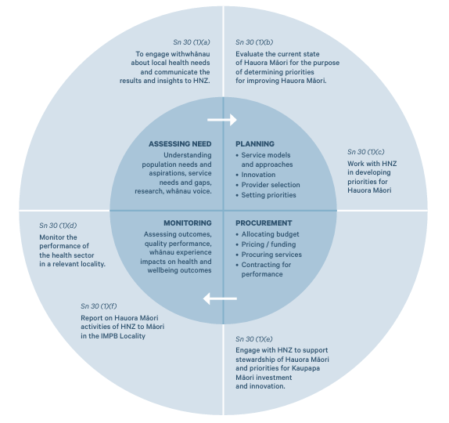
NEXT STEPS
Announce/introduce Advisory Panel to enable collaboration and empowerment
Review feedback on the Community Health Plan from Te Whatu Ora
Ensure our priorities are captured in Regional Health and Wellbeing Plans
Continue to grow capability in the areas of commissioning, social investment, insights and intelligence.
Publish DASHBOARDS to encourage awareness and involvement in tracking the performance of the Health System.
October 2024
PROGRESS REPORT FOR MATARIKI GOVERNANCE GROUP
18

Slide 20
TIHEI TĀKITIMU
IWI MĀORI PARTNERSHIP BOARD
PĀTAI / QUESTIONS
Kerri Nuku | Co-Chair
Lewis R﻿atapu | Co-Chair
nukuz@xtra.co.nz
lewis.ratapu@ttpb.maori.nz
www.ttpb.maori.nz

